Slide 1
Natural Language Processing DSECL ZG565
Prof.Vijayalakshmi
BITS-Pilani

Slide 2
Session 7 - Dependency Parsing
Date – 11th October 2020
Time – 9 am to 11 am
These slides are prepared by the instructor, with grateful acknowledgement of Prof. Jurafsky and Prof. Martin and many others who made their course materials freely available online.

Slide 3

Recap
CKY parsing
PCFG parsing
Problems with PCFG
Lexicalized PCFGS

Slide 4
Outline
Motivation
Two types of parsing
Dependency parsing
Phrase structure parsing
Dependency structure and Dependency grammar
Dependency Relation
Universal Dependencies
Method of Dependency Parsing
Dynamic programming
Graph algorithms
Constraint satisfaction
Deterministic Parsing
Transition based dependency parsing
Graph based dependency Parsing
Evaluation

Slide 5



Interpreting Language is Hard!
I saw a girl with a telescope
●
“Parsing” resolves structural ambiguity in a formal way
2

Slide 6
Two Types of Parsing
Dependency: focuses on relations between words
●
I saw a girl with a telescope
●
Phrase structure: focuses on identifying phrases and their recursive structure
S
VP
PP
NP
PRP VBD DT NN IN DT NN
NP
NP
I saw a girl with a telescope
3

Slide 7
Dependencies Also Resolve Ambiguity
I saw a girl with a telescope
I saw a girl with a telescope
4

Slide 8
Dependency Grammar and Dependency Structure
Dependency syntax postulates that syntactic structure consists of lexical items linked by binary asymmetric relations (“arrows”) called dependencies
submitted
nsubjpass
auxpass
prep
The arrows are commonly typed with the name of grammatical relations (subject, prepositional object, apposition, etc.)
Bills
were
by
prep
pobj
on
Brownback
pobj
nn
appos
ports
Senator
Republican
cc
conj
prep
and
immigration
of
pobj
Kansas

Slide 9
Dependency Grammar and Dependency Structure
The arrow connects a head (governor, superior, regent) with a dependent (modifier, inferior, subordinate)
Usually, dependencies form a tree (connected, acyclic, single-head)
submitted
nsubjpass
auxpass
prep
Bills
were
by
prep
pobj
on
Brownback
pobj
nn
appos
ports
Senator
Republican
cc
conj
prep
and
immigration
of
pobj
Kansas
Notes:
The arrows may be drawn in either direction.
If tree height is used to show governor, then you don’t need arrows at all.
Mention ROOT and draw it in.

Slide 10
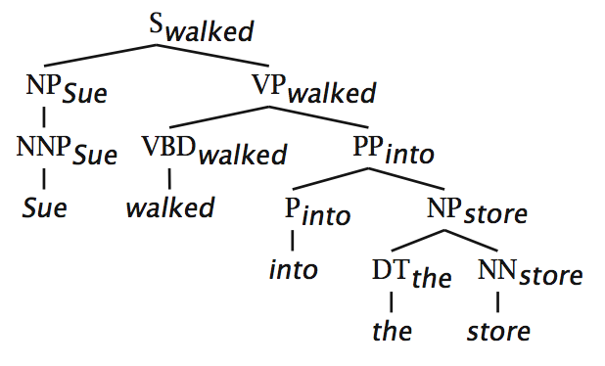
Relation between phrase structure and dependency structure
A dependency grammar has a notion of a head. Officially, CFGs don’t.
But modern linguistic theory and all modern statistical parsers (Charniak, Collins, Stanford, …) do, via hand-written phrasal “head rules”:
The head of a Noun Phrase is a noun/number/adj/…
The head of a Verb Phrase is a verb/modal/….
The head rules can be used to extract a dependency parse from a CFG parse
The closure of dependencies give constituency from a dependency tree
But the dependents of a word must be at the same level (i.e., “flat”)

Slide 11
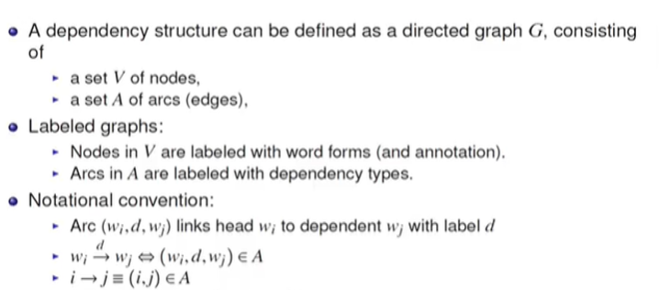
Dependency graph

Slide 12
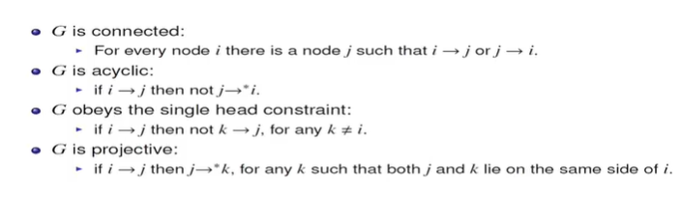
Formal conditions on dependency graph

Slide 13
Universal dependencies
http://universaldependencies.org/
• Annotated treebanks in many languages
• Uniform annotation scheme across all languages:
• Universal POS tags
• Universal dependency relations

Slide 14
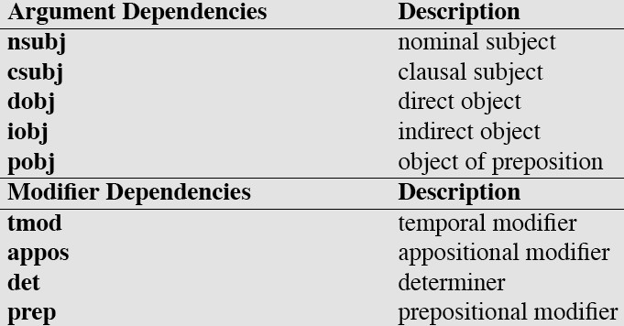

Dependency Relations

Slide 15
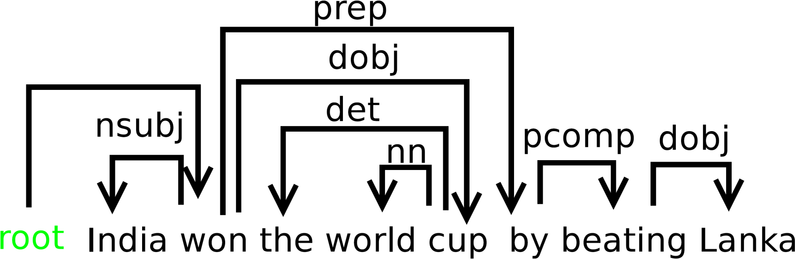
Example Dependency Parse

Slide 16
Method of Dependency Parsing

Slide 17
Methods of Dependency Parsing
Dynamic programming (like in the CKY algorithm)
You can do it similarly to lexicalized PCFG parsing: an O(n⁵) algorithm
Eisner (1996) gives a clever algorithm that reduces the complexity to O(n³), by producing parse items with heads at the ends rather than in the middle
Graph algorithms
You create a Maximum Spanning Tree for a sentence
McDonald et al.’s (2005) MSTParser scores dependencies independently using a ML classifier (he uses MIRA, for online learning, but it could be MaxEnt)
Constraint Satisfaction
Edges are eliminated that don’t satisfy hard constraints. Karlsson (1990), etc.
Deterministic parsing
Greedy choice of attachments guided by machine learning classifiers
MaltParser (Nivre et al. 2008) – discussed in the next segment

Slide 18
Deterministic parsing

Slide 19
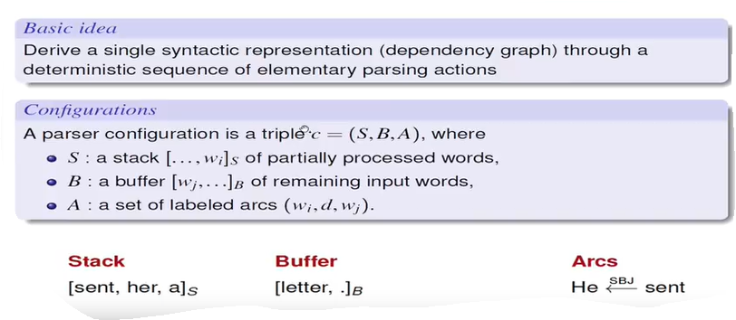
Deterministic parsing

Slide 20
Transition based systems for Dependency parsing
A transition system for dependency parsing is a quadruple s=(C,T, cs, Ct),where
C is a set of configurations
T is a set of transitions ,such that t:C->c,
Cs is an initialization function
is asset of terminal configurations.
A transition sequence for a sentence x is a set of configurations
C0,m =(c0,c1….cm) such that
C0=Cs(x),cm belongs to Ct ,ci=t(ci-1) for some t belongs to T
Initialization:[]s,[w1,w2…….wn]b,{})
Termination: S,[]B,A

Slide 21
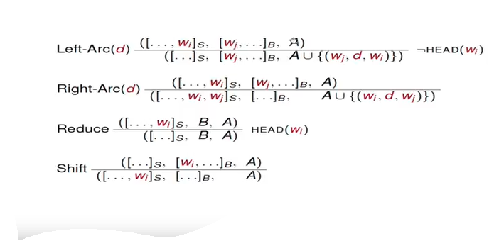
Arc eager parsing(Malt parser)

Slide 22
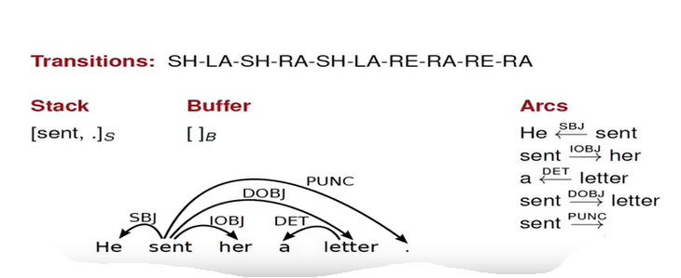
Example1

Slide 23
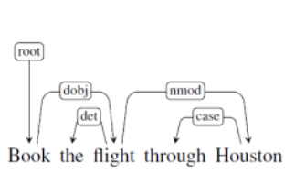
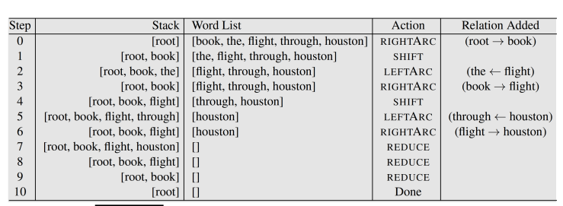
Example2

Slide 24
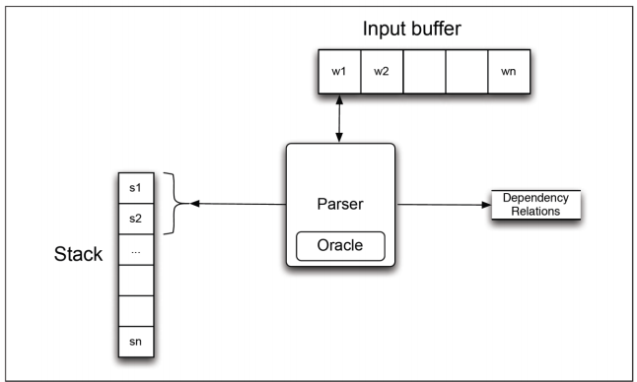
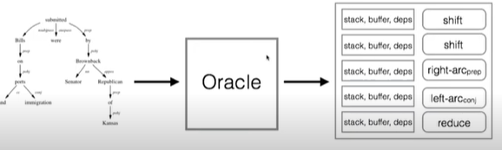
Creating an Oracle

Slide 25
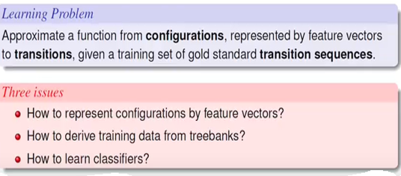
How the classifier the learns ?

Slide 26
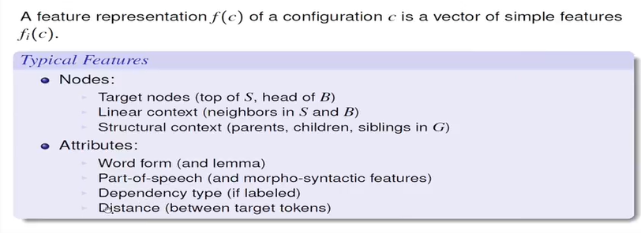
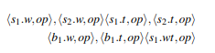
Feature Models
Feature template:

Slide 27
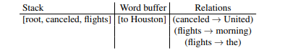
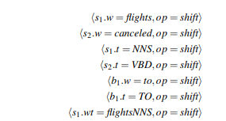
Feature examples

Slide 28
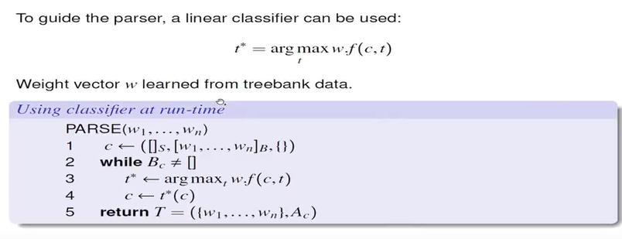
Classifier at runtime

Slide 29
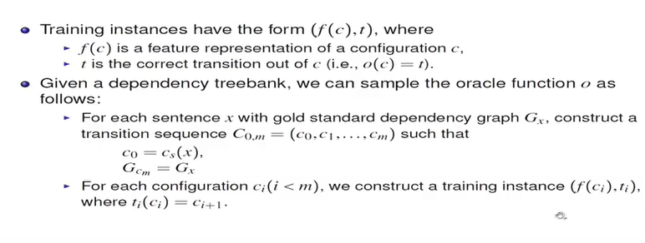
Training Data

Slide 30
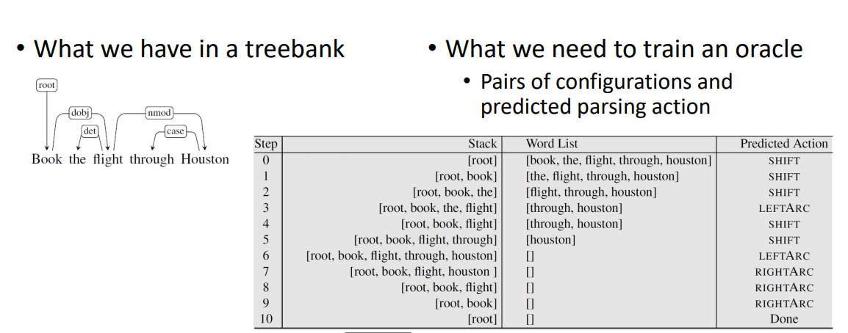
Generating training data example

Slide 31
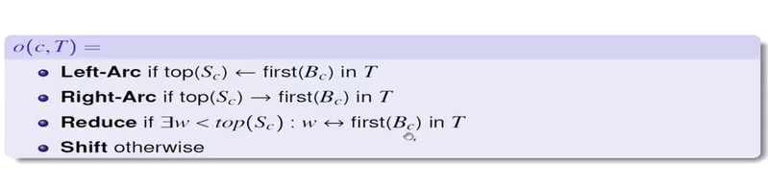
Standard Oracle for Arc Eager parsing

Slide 32
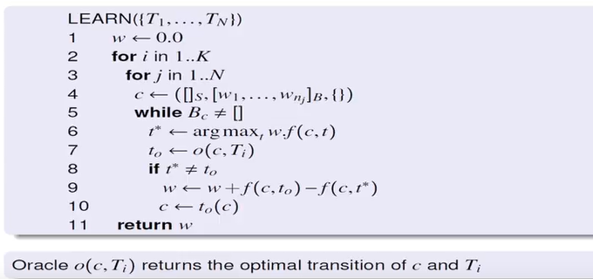
Online learning with an oracle

Slide 33
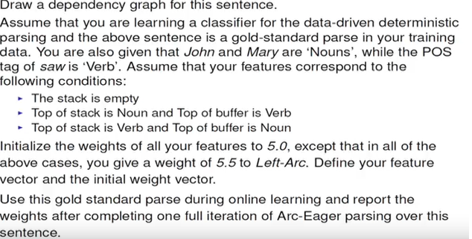
Example

Slide 34
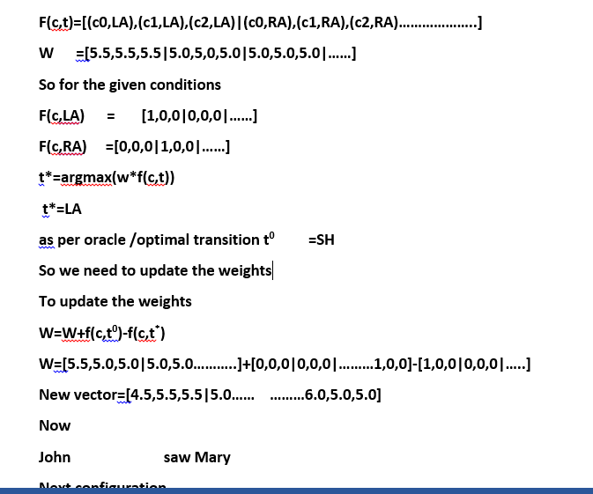

Slide 35
Graph-based parsing

Slide 36
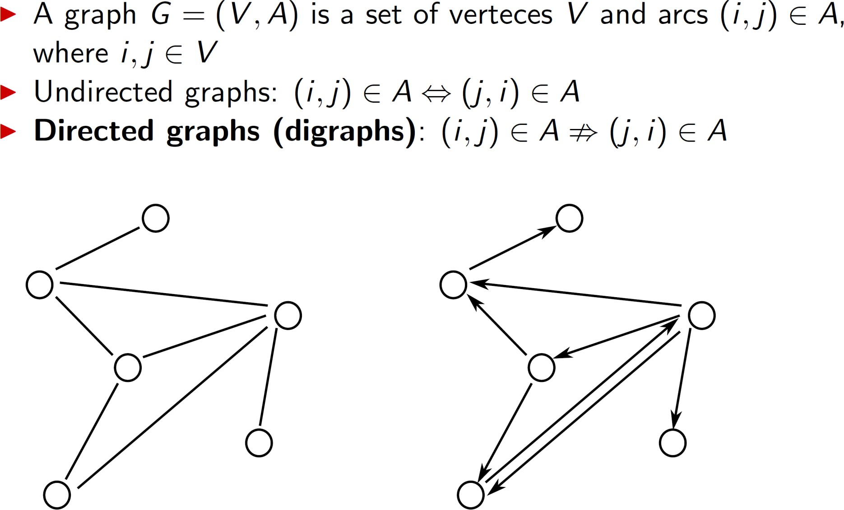
Graph concepts refresher

Slide 37
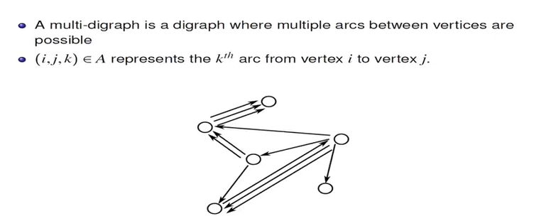
Multi Digraph

Slide 38
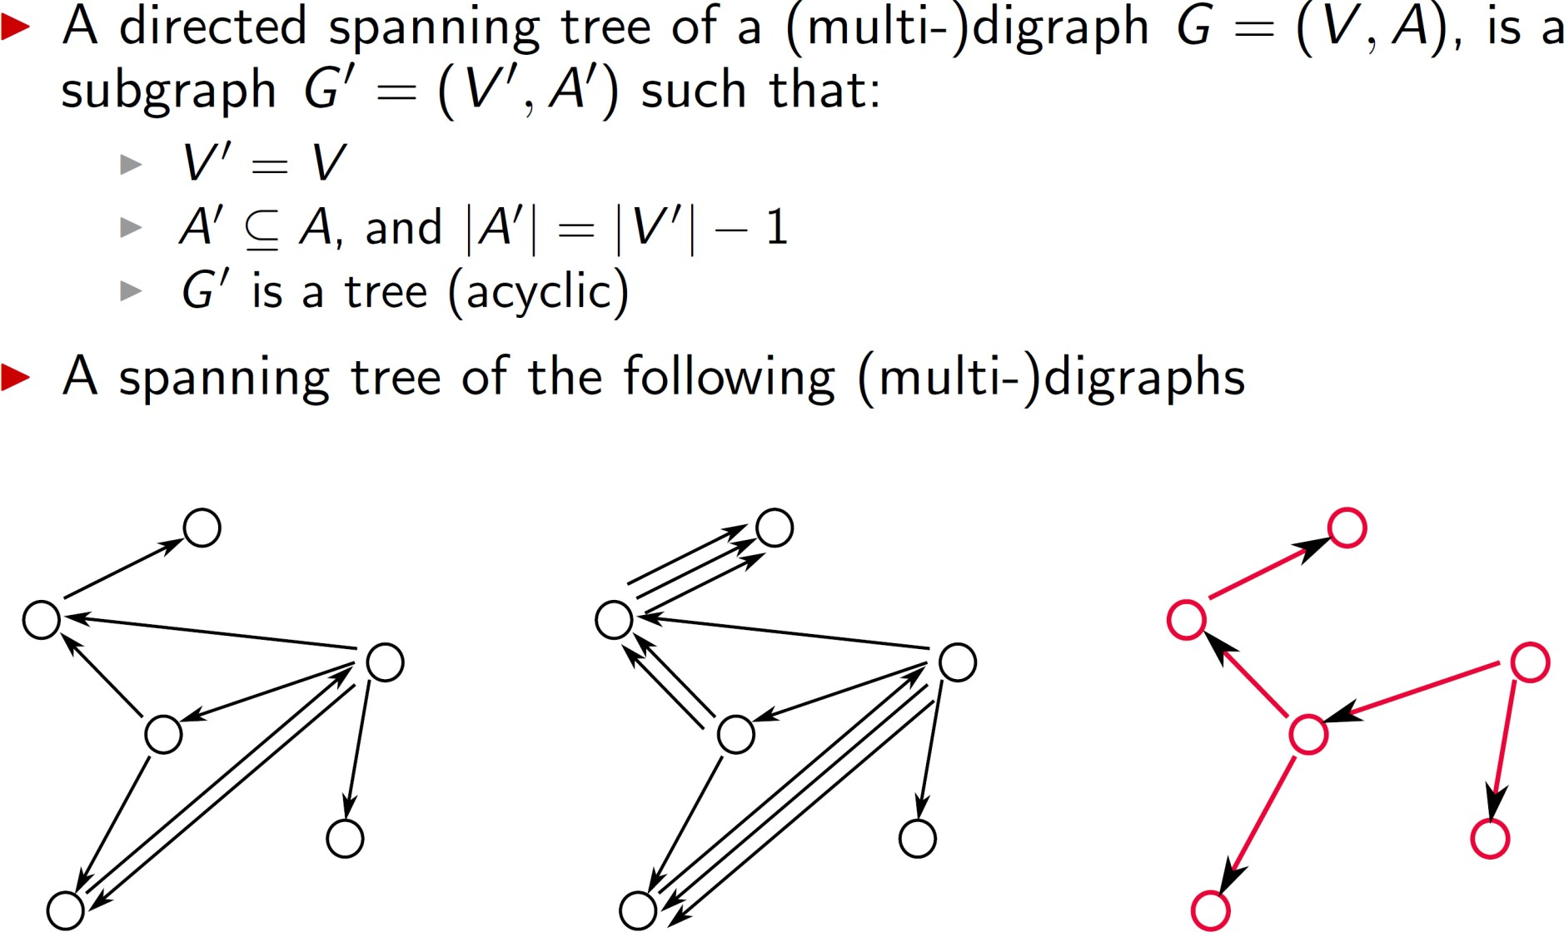
Directed Spanning Trees

Slide 39
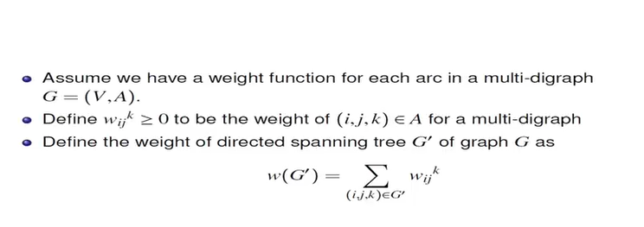
Weighted Spanning tree

Slide 40
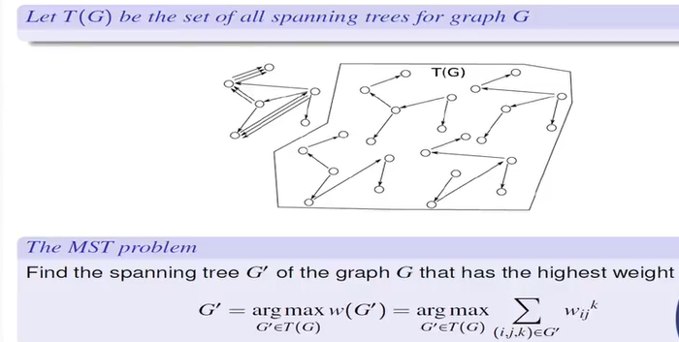
MST

Slide 41
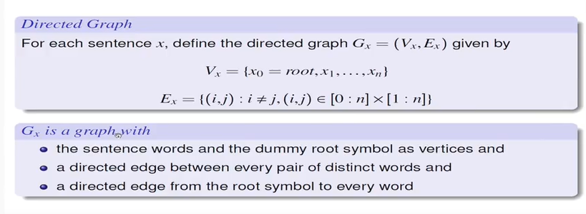
Finding MST

Slide 42
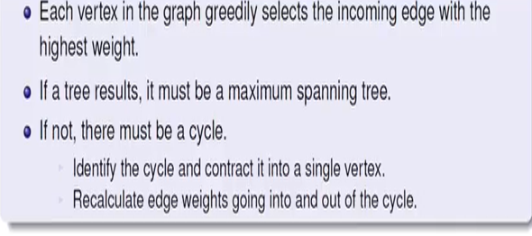
Chu-Liu-Edmonds algorithm

Slide 43
Chu-Liu-Edmonds Algorithm (2/12)
x = John saw Mary
G_{x}
9
10
30
root
0
Mary
saw
9
20
30
John
11
3

Slide 44
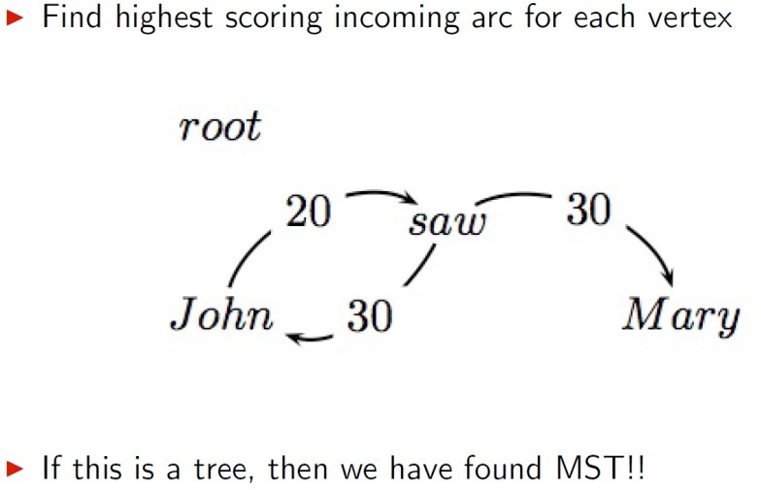
Chu-Liu-Edmonds Example

Slide 45
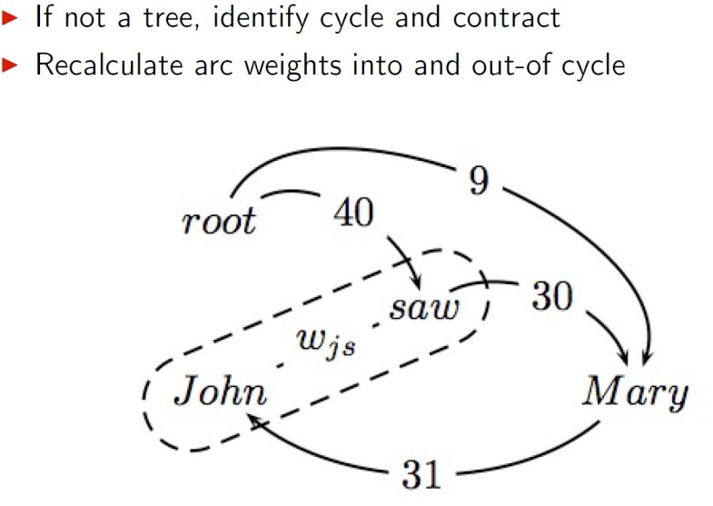
Chu-Liu-Edmonds Example

Slide 46
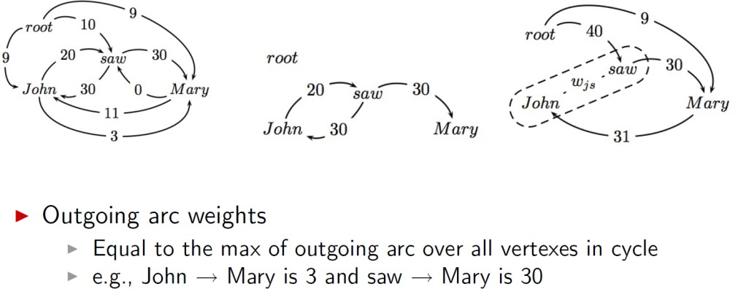
Chu-Liu-Edmonds Example

Slide 47
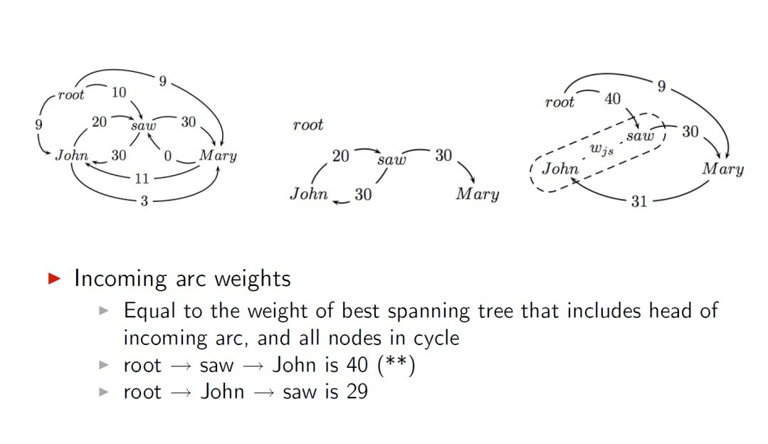
Chu-Liu-Edmonds Example

Slide 48
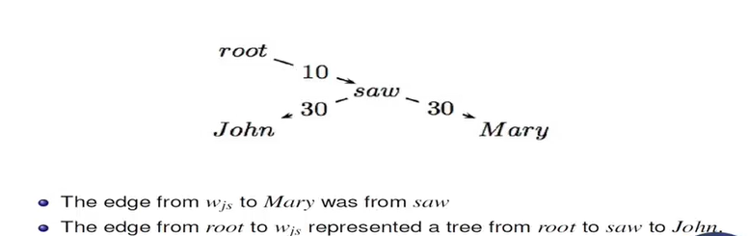
Chu-Liu-Edmonds Example

Slide 49
MST Learning

Slide 50
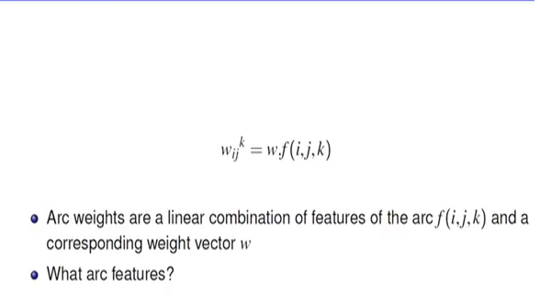
Linear classifiers

Slide 51
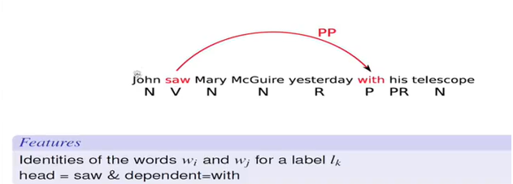
Arch features

Slide 52
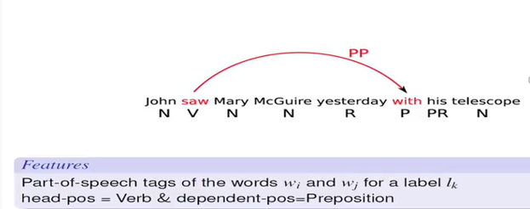

Slide 53
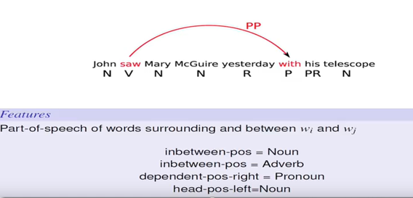

Slide 54
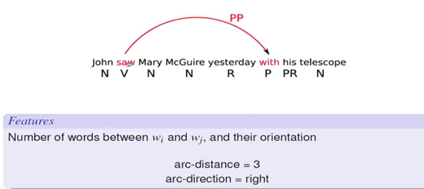

Slide 55
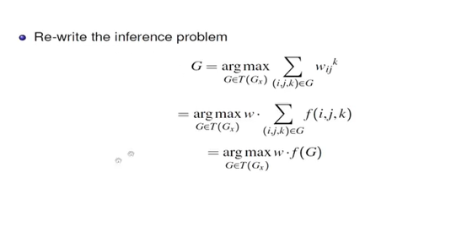
Learning the parameters

Slide 56
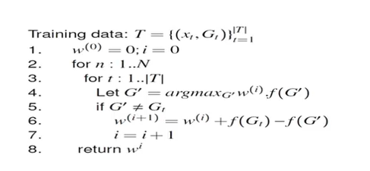
Inference based learning

Slide 57
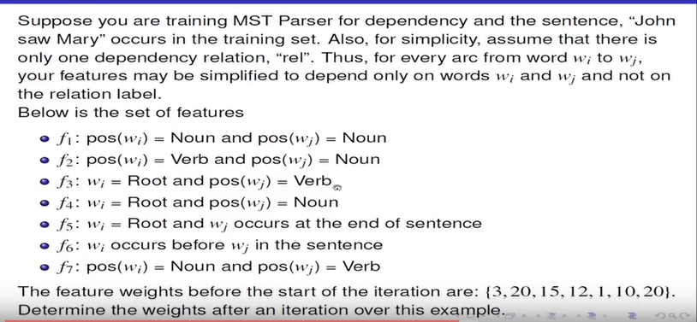

Slide 58
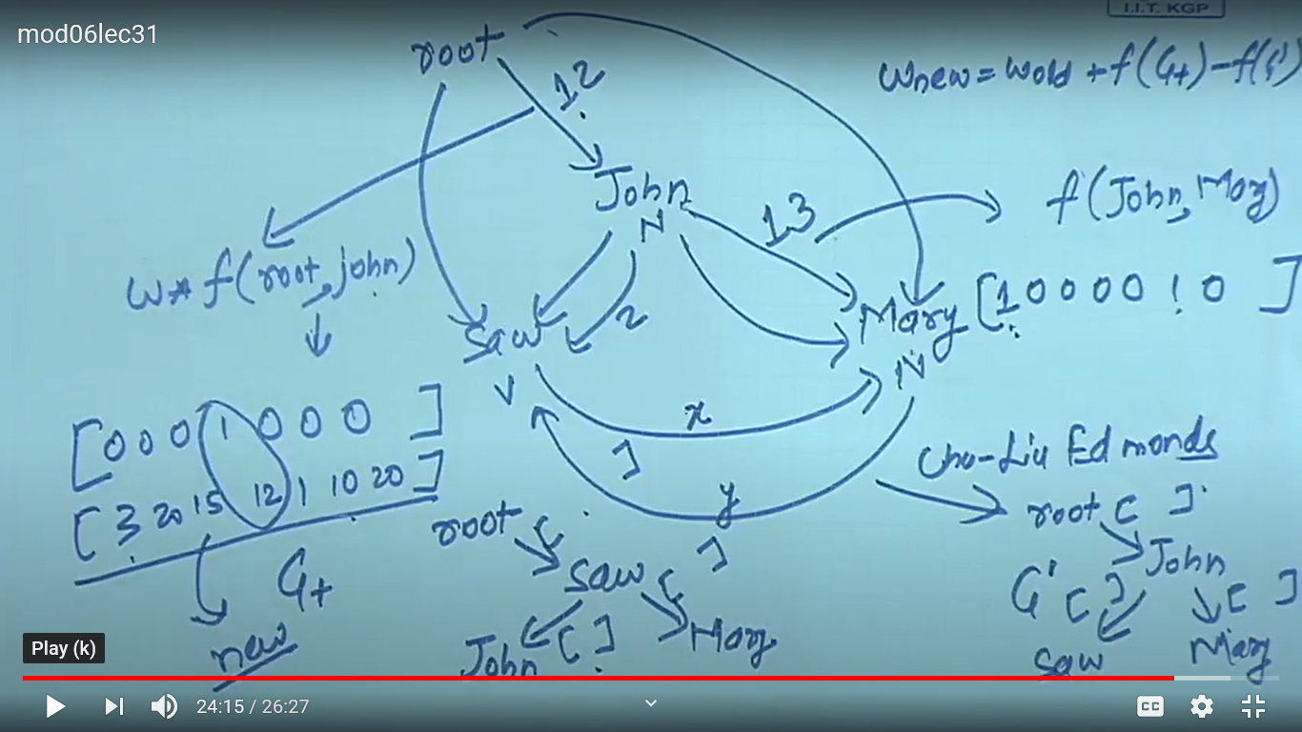
EXAMPLE

Slide 59
Evaluation
Acc = # correct deps
# of deps
ROOT She saw the video lecture
0 1 2 3 4 5
UAS(unlabeled attachment score) = 4 / 5 = 80%
LAS = 2 / 5 = 40%
Gold
2 She nsubj
0 saw root
5 the det
5 video nn
2 lecture dobj
Parsed
2 She nsubj
0 saw root
4 the det
5 video nsubj
2 lecture ccomp

Slide 60
References
1.Speech and Language processing: An introduction to Natural Language Processing, Computational Linguistics and speech Recognition by Daniel Jurafsky and James H. Martin[3rd edition].
2. https://www.youtube.com/watch?v=PVShkZgXznc
3.https://www.youtube.com/watch?v=02QWRAhGc7g&list=PLJJzI13YAXCHxbVgiFaSI88hj-mRSoMtI
4.https://www.researchgate.net/publication/328731166_Weighted_Machine_Learning

Slide 61
Any Questions?

Slide 62
Thank you

